Slide 1
What is IoT ?
The Internet of Things (IoT) is the network of physical objects—devices, vehicles, buildings and other items embedded with electronics, software, sensors, and network connectivity—that enables these objects to collect and exchange data.
Connecting any device (including everything from cell phones, vehicles, home appliances and other wearable embedded with sensors and actuators) with Internet so that these objects can exchange data with each other on a network.
It is interesting to note that there is a difference between IoT and the Internet ,it is the absence of Human role.

Slide 2
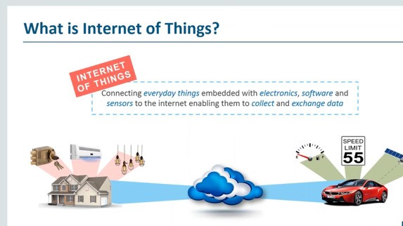

Slide 3
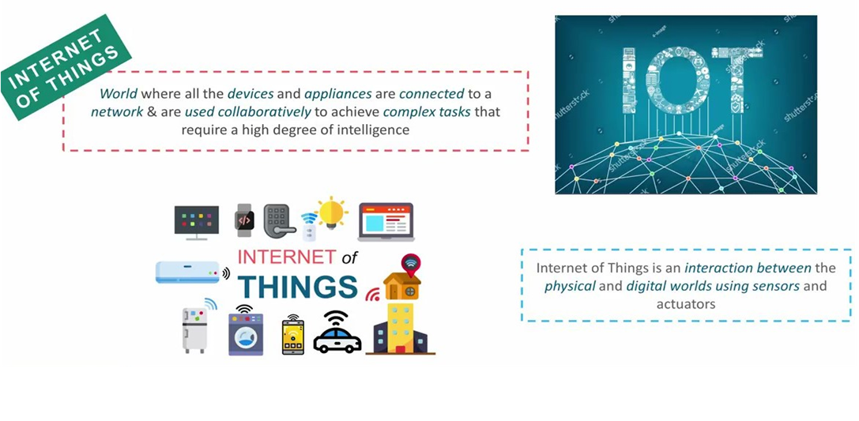

Slide 4
Various Names, One Concept
M2M (Machine to Machine)
“Internet of Everything” (Cisco Systems)
“World Size Web” (Bruce Schneier)
“Skynet” (Terminator movie)

Slide 5
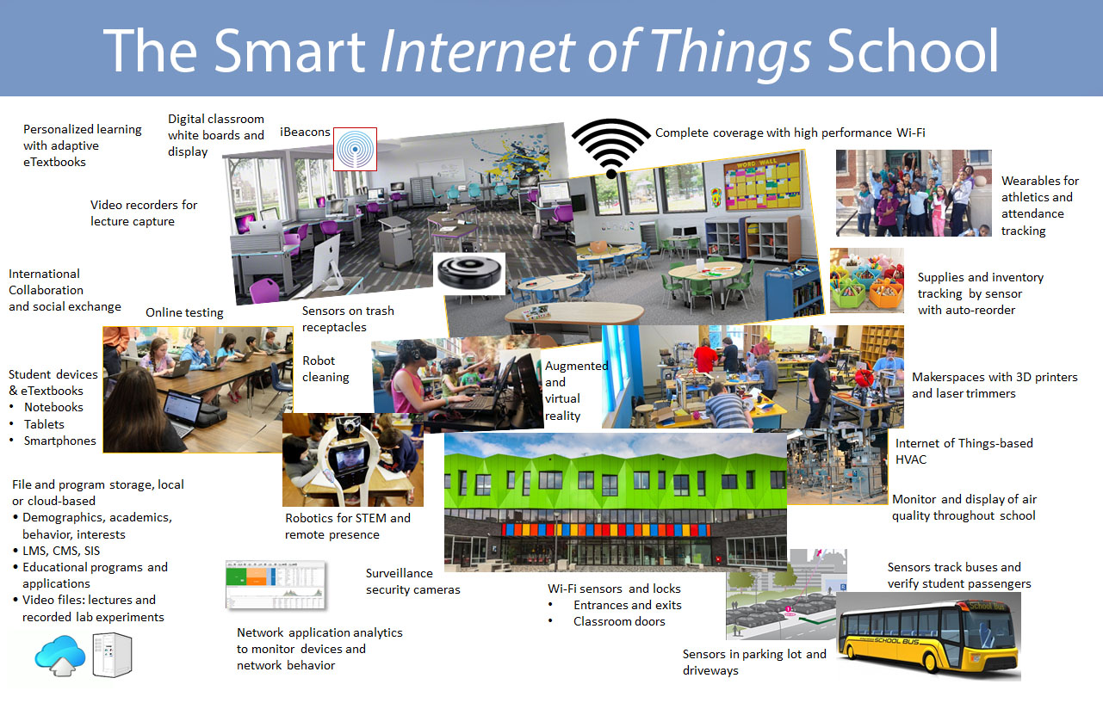

Slide 6
What exactly the internet of things ?
Smart System and the Internet of the Things are driven by a combination for:
Sensors & Actuators
Connectivity
People & Process

Slide 7
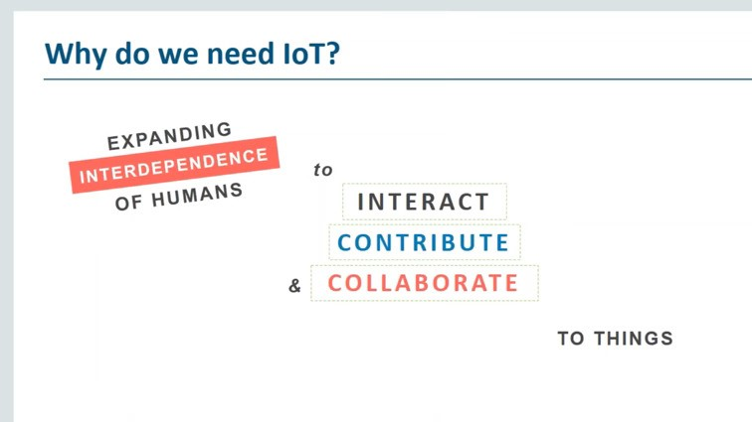

Slide 8
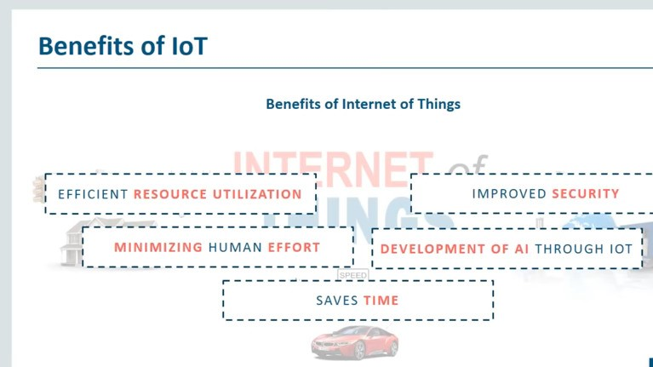

Slide 9
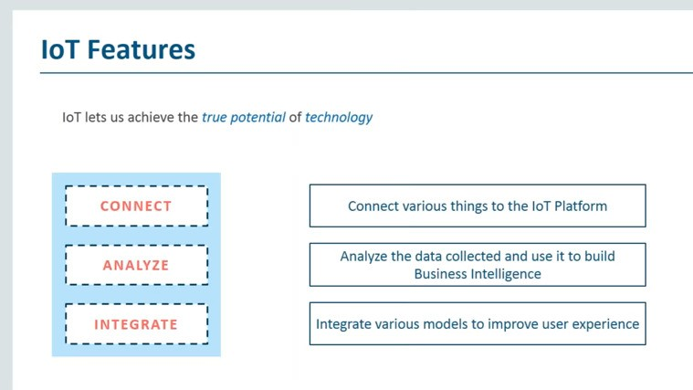

Slide 10
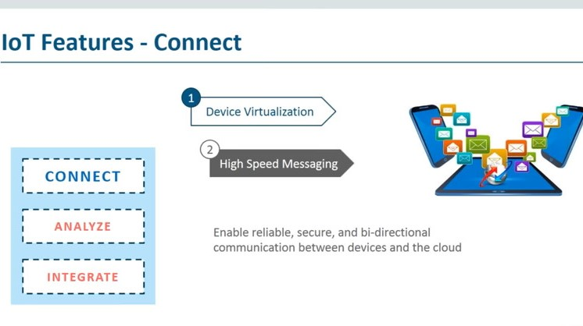

Slide 11
